Slide 1
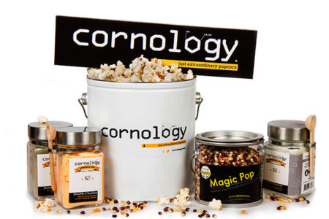
Cornology Case Study Optimization for Market Entry Prof. Omar Romero – Hernandez Prof. Chase Kusterer
Team 5
Jenny Cruz | Joshuva John | Karam Said | Mafalda Lanca de Morais | Paolo Musone

Slide 2



Cornology
Brief Company History
Company history
Best-Selling Popcorn Flavours
Cornology was founded on March 11, 1992 in Bangkok, Thailand.
The company has a product portfolio containing more than 300 flavors of popcorn that has become a necessity as well as a tradition in Thai cinemas.
Original
“The flavor is familiar but it’s difficult to describe. What’s even more difficult is trying to stop reaching into the popcorn bag to have some more. I hope it’s healthy!”
Primary Business
Flavor Blast
Sell popcorn to cinemas throughout the country, Thailand.
“This popcorn is super rich, but it doesn’t make me thirsty. I’m not so sure I can eat a large serving by myself. However, this would be perfect if I was with another person.”

Slide 3
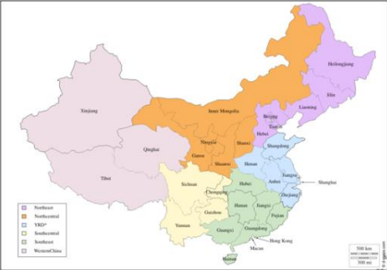

Cornology
Expansion Strategy
Cornology wants to expand its business to China.
For that is considering 4 locations to build the factory:
Possible entry locations:
Nong Khai
Chiang Rai
Factory Cost: $M 11.3
Factory Cost: $M 11.5
Port of Entry: Northeast
Moderated developed area
Port of Entry: North Central
Bangkok
Yala
Factory Cost: $M 24.1
Factory Cost: $M 10.3
Most developed area
Least developed area
High land value
Low land value
Port of Entry: Yangtze River Delta
Port of Entry: Western China
*Values of factory costs are based on the excel calculations

Slide 4
Cornology
Solving the case
Conditions
Raw material availability per run: 1,350,000 kg seeds and 1,575,000 bottles.
One run can make maximum of 90 units of Original or 70 units Flavour Blast.
We got a maximum of 5 runs.
At least 90% of the total demand must be met before moving to the next location.

Slide 5
Cornology
Objective Function
MAX
Profit[Original] x Sum(Demand of Original*Location)
+
Profit[Blast Flavour] x Sum(Demand of Blast Flavour*Location)

Slide 6
Cornology
Constraints
The number of runs has to be equal or lower than 5
Sum (Runs Required*Location) <= 5
Both Original and Flavor Demands should be satisfied for the location.
Northeast Original == Northeast Flavor Blast
Both Original and Flavor Demands should be satisfied for the location.
Yangtze River Delta Original == YRD Flavor Blast
Southeast Original == Southeast Flavor Blast
Both Original and Flavor Demands should be satisfied for the location.
North Central Original == North Central Flavor Blast
Both Original and Flavor Demands should be satisfied for the location.
South Central Original == South Central Flavor Blast
Both Original and Flavor Demands should be satisfied for the location.
Western China Original == Western China Flavor Blast
Both Original and Flavor Demands should be satisfied for the location.
WC Orig +WC Flavor +YRD Orig +YRD Blast <=2
Removing the unfeasible region with high profit.

Slide 7






Cornology
Recommendations
Best option: Chiang Rai
Objective Value / Max Profit:
$ 3, 680, 000
Build the factory in Chiang Rai
Cost of $ 11, 488, 001
Market Entry:
1st North Central
2nd South Central
Payback period:
3 years and 3 months

Slide 8




Why didn’t we choose any of the other locations?
The other locations (except for Nong Khai) they perform far worse on these Indexes.
Second Best Option
Factory in Nong Khai:
North Central-> YRD
-2% profitable
than Chiang Rai
Less profitable
Longer Payback period
Same Payback time
as Chiang Rai
+2% sales
compared to Chiang Rai
Less Sales

Slide 9
Appendix
Objective Value (1/2)

Slide 10
Appendix

Slide 11
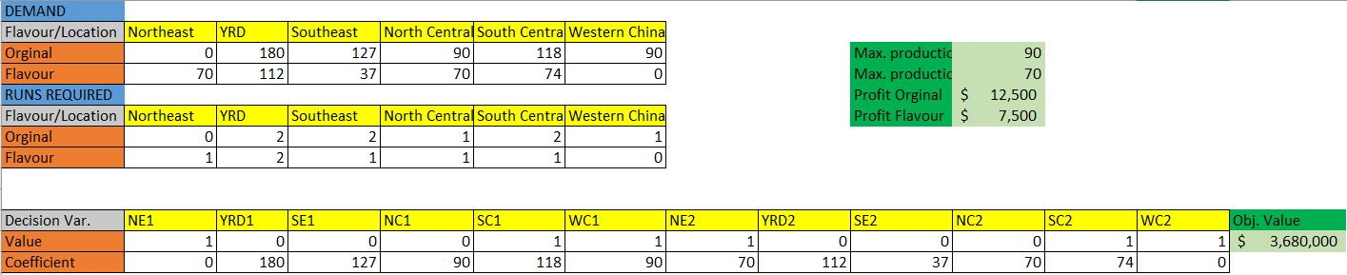
Appendix
Objective Value (2/2)

Slide 12
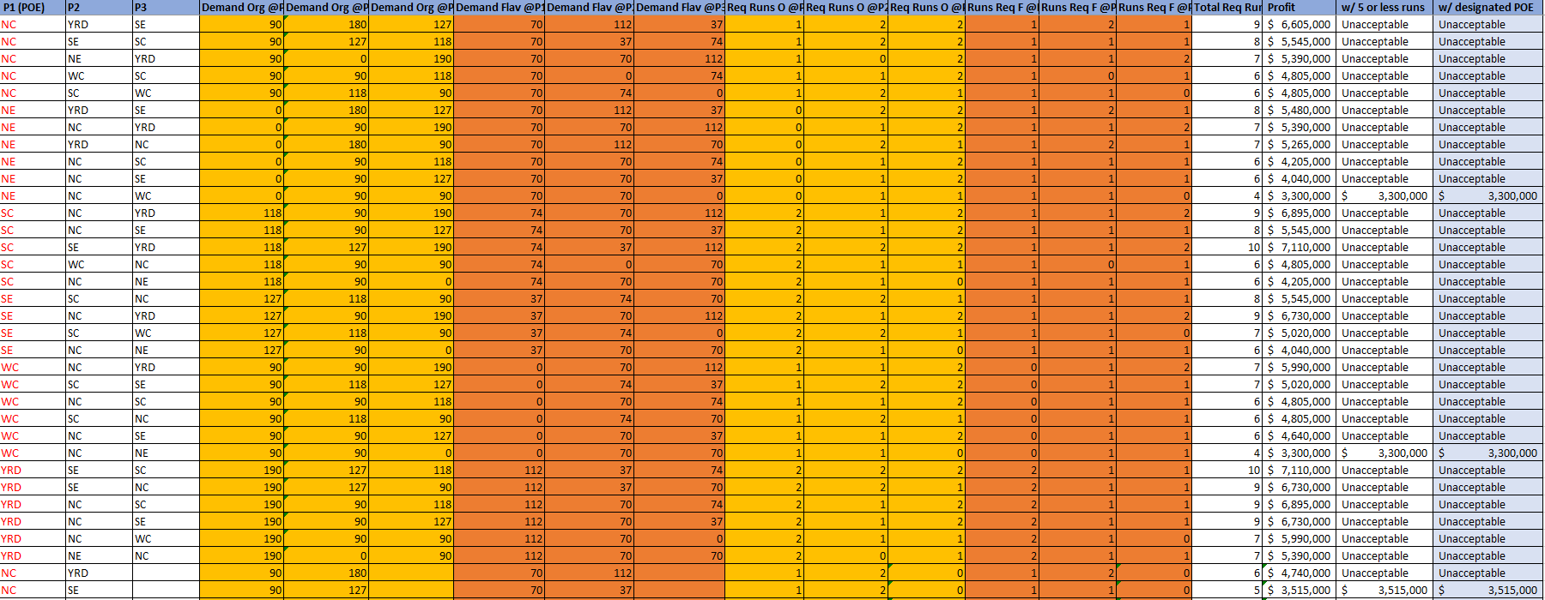
Appendix
All feasible routes (1/2)

Slide 13
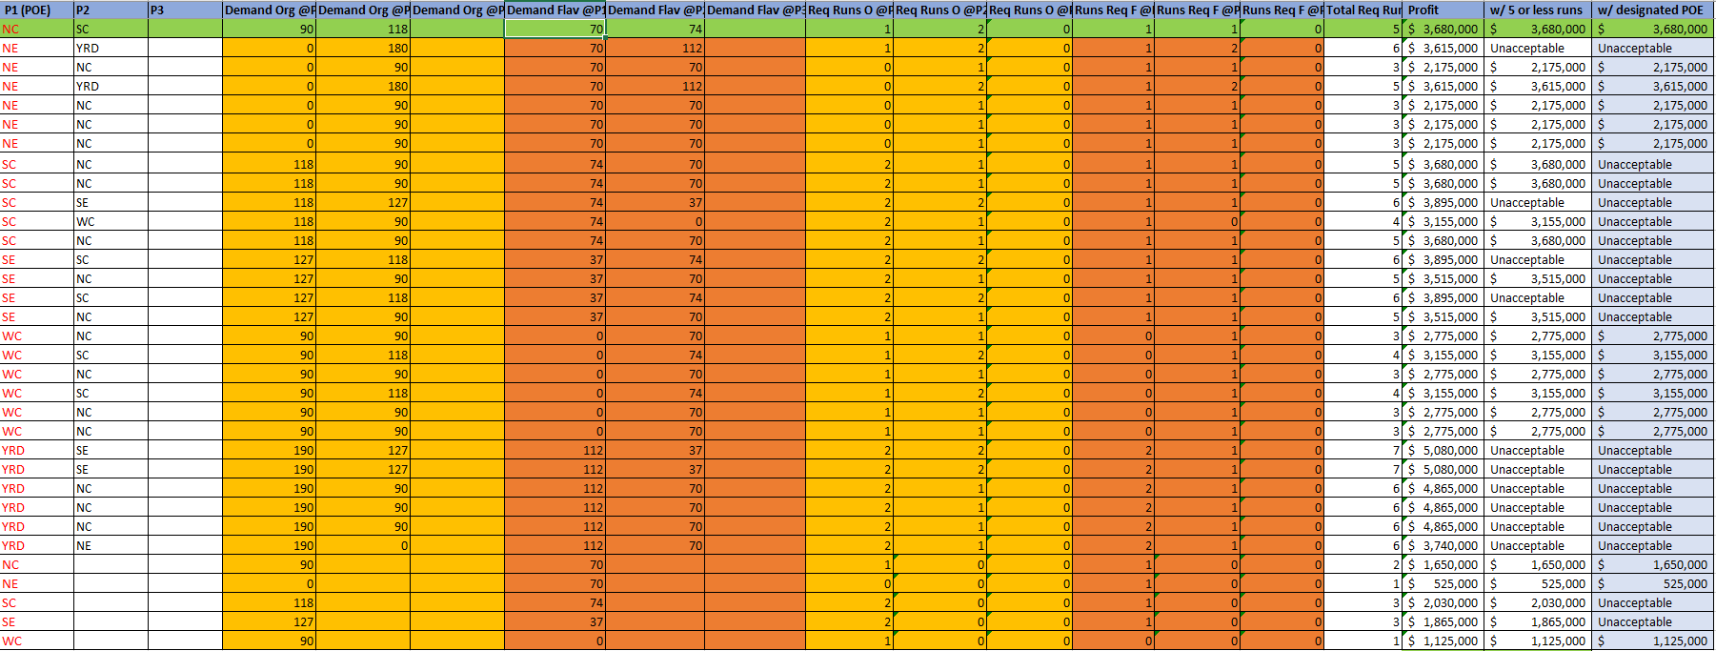
Appendix
All feasible routes (2/2)

Slide 14
Appendix
Python Code

Slide 15
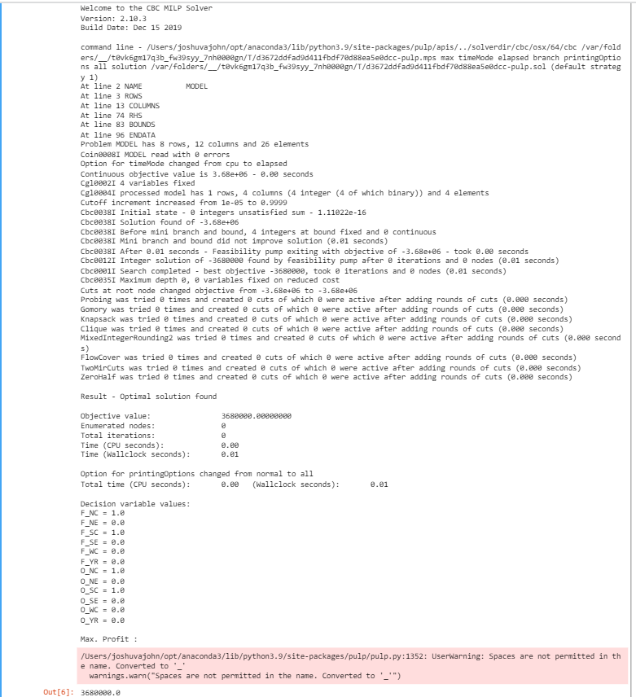
Appendix
Python Output

